Slide 1





Grow Mate
Your agricultural partner
Crop and fertilizer recommendation along with disease
identification and prescribed supplements
Team Members
Guide
1. Sankit Binkar
2. Harshal Borkar
3. Nayana Pardhekar
4. Harsh Gathode
5. Aditya Mate
Akshay Chaskar

Slide 2

Course Outline
Problem Statement
Proposed System/Solution
Software Requirements
System Design/Architecture
Demo Link
Conclusion
Future Scope
Notes:
These are the list of chapters that we are going to cover in these foundation codes. Those are chapter one what are AI and ML? chapter 2 applied Python programming in AI, and chapter 3 is exploratory data analysis for ML.

Slide 3


Problem Statement
Farmers face challenges in optimizing crop selection to maximize yield while efficiently utilizing resources. Existing methods often lack precision and fail to account for various environmental factors. This project addresses the gap by proposing a machine learning-based crop and fertilizer recommendation system. It is also difficult to identify Disease and it's cure. Its' also difficult to find expert help for this.

Slide 4
Proposed Solution
Empowering Agriculture for a Sustainable Future
1
2
3
Advanced recommendation system
Intelligent disease detection
Latest cultivation technologies.
4
5
Repository of government schemes and subsidies.
Promote sustainable agricultural practices

Slide 5
Software Requirements
Microsoft
Azure
Random Forest Classifier
Mobile Net V2 – CNN Algorithm
Docker
OpenAI API
OpenWeather API
Streamlit
VS Code &
Python Libraries

Slide 6
System Architecture
Crop Recommendation:
Found Random Forest Classifier as best
Accuracy: 99.5%
Dataset Collection and Preprocessing
Compare different algorithm
Finding Insights
Model Building
Developed web application using flask along with API integration
Disease Identifier:
Dataset Collection and Preprocessing
MobileNetV2 Algorithm used
Model Building
Found accuracy of 98.24%

Slide 7

Demo Link
GrowMate Link :
https://growmate-youragriculturepartner.azurewebsites.net/
Scan QR to visit GrowMate

Slide 8

Conclusion
GrowMate: Machine Learning based system provides a robust and data-driven approach for farmers to make informed decisions, fostering sustainable agriculture practices and optimizing crop yield in varying environmental conditions. This tool contributes to the modernization of farming strategies.
Notes:
8

Slide 9

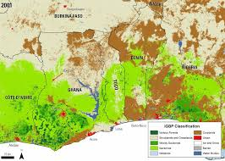
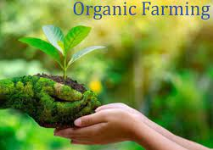

Future Scope
Include land type for predicting best crop.
Focusing more on organic farming methods with new cultivation techniques.
Access to Government schemes and subsidies easily.
Database Integration

Slide 10
Thank you!
Notes:
Thank you very much for joining this PPT, keep learning.
10

